Slide 1
Ross Stores & DD’s Discounts
Accessing Supplier Portal

Slide 2
Supplier Portal – Login
URL: https://vendors.rossstores.com
0.1 First Time Login
0.2 Daily Login
0.3 Forgot Password
3

Slide 3
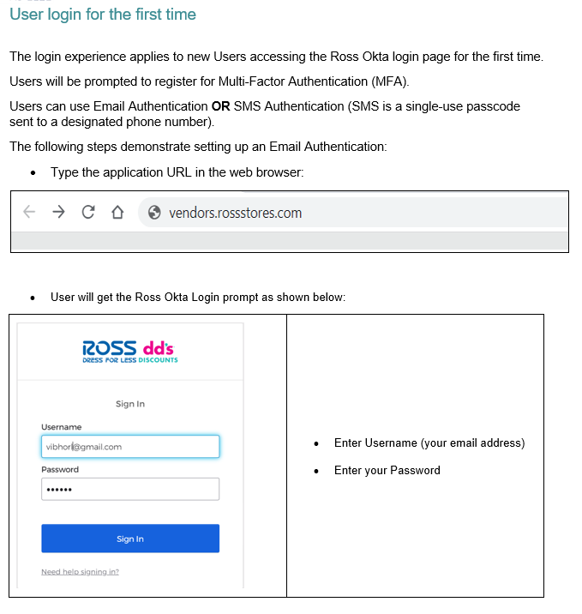
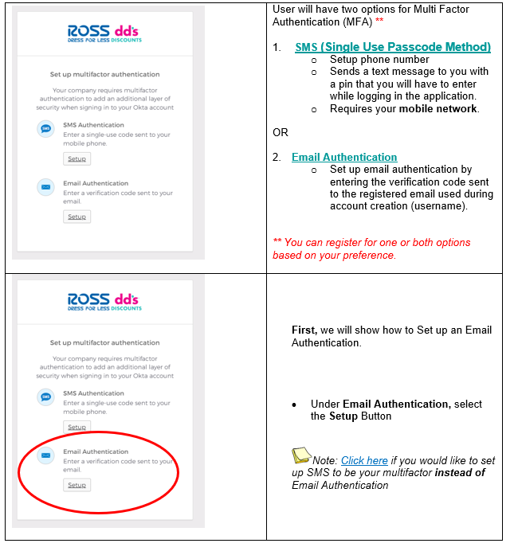
0.1 Supplier Portal – First time Login
d
f
g
a
b
4

Slide 4
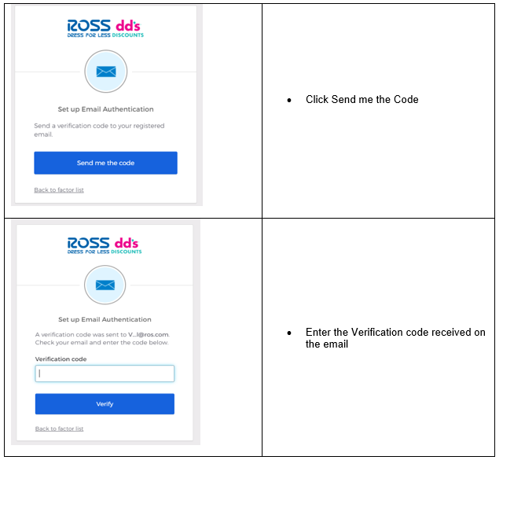
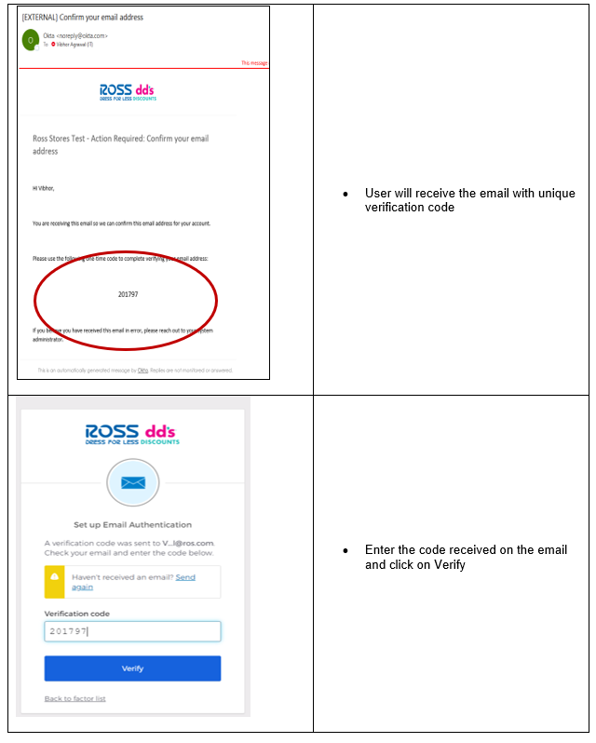
0.1 Supplier Portal – First time Login
d
f
g
a
b
5

Slide 5
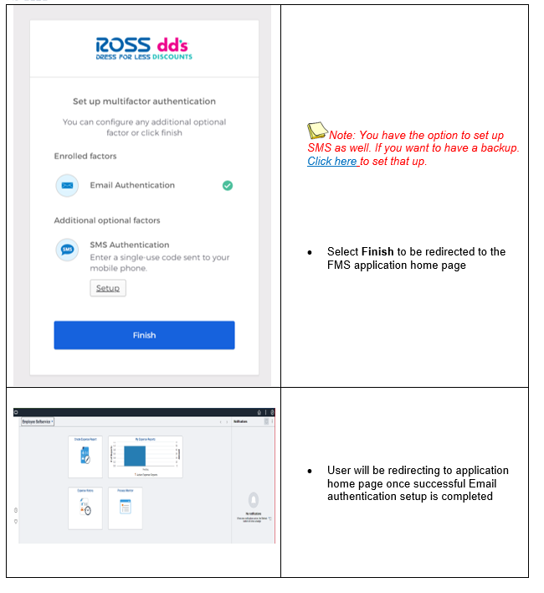
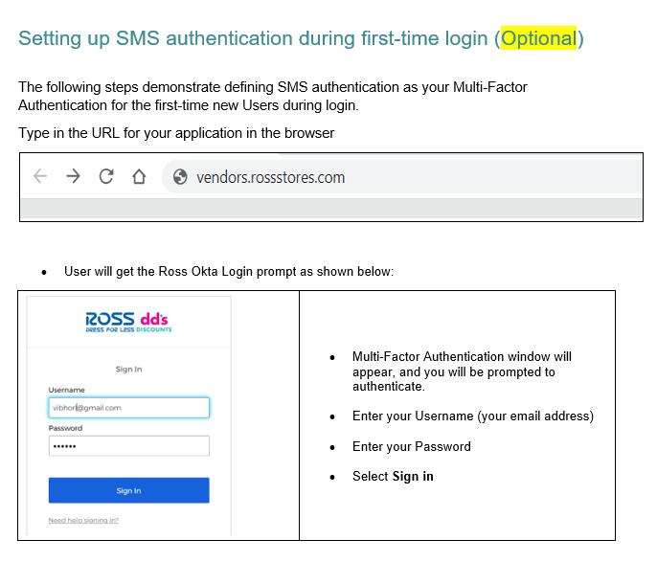
0.1 Supplier Portal – First time Login
6

Slide 6
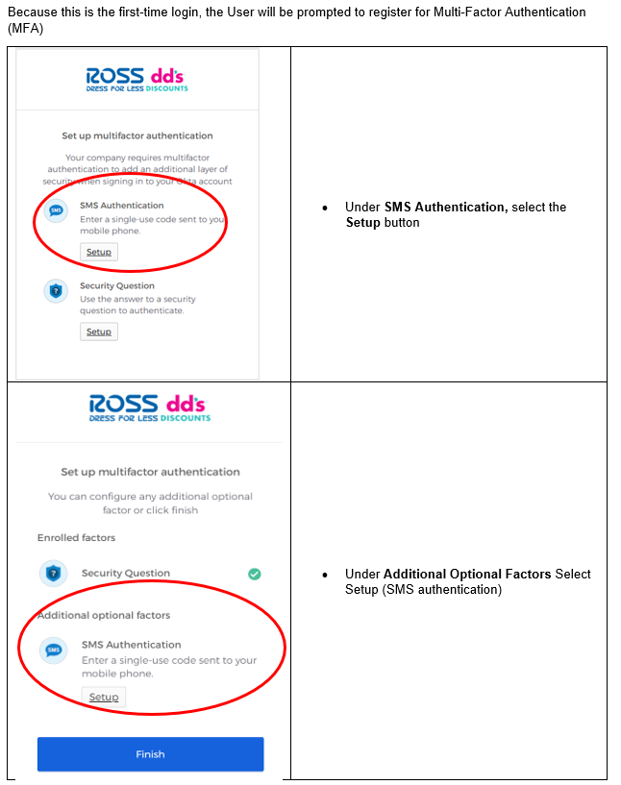
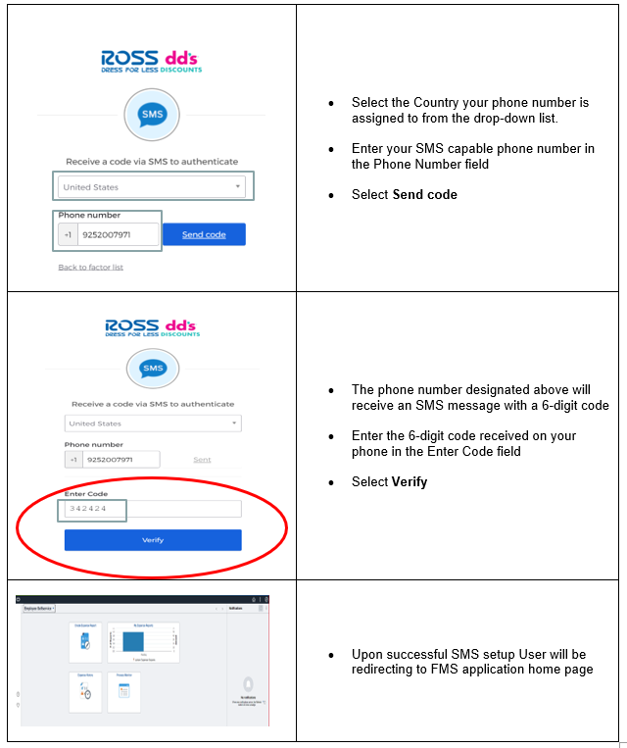
0.1 Supplier Portal – First time Login
7

Slide 7
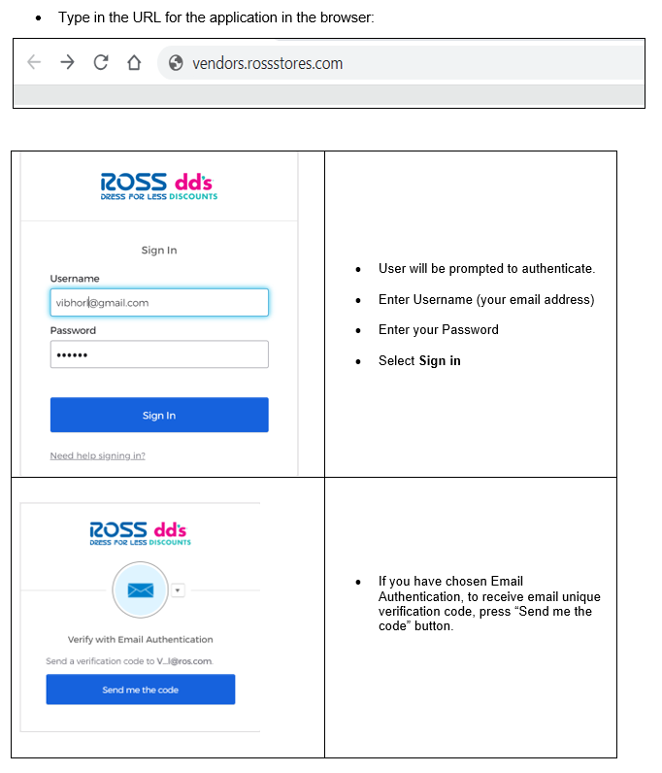
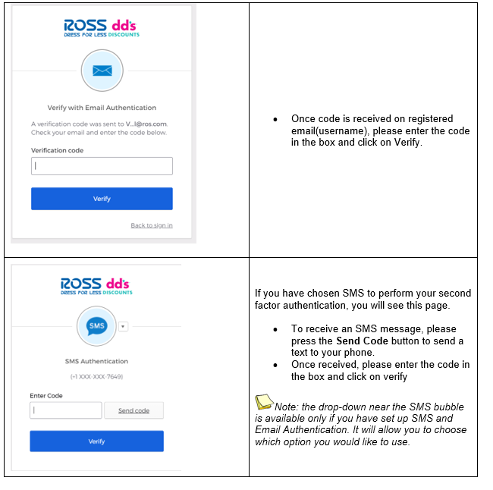
0.2 Supplier Portal – Daily Login
8

Slide 8
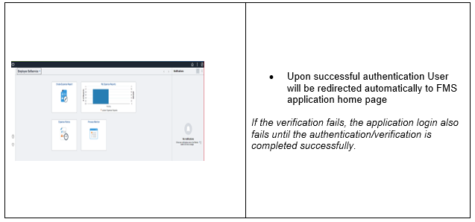
0.2 Supplier Portal – Daily Login
9

Slide 9
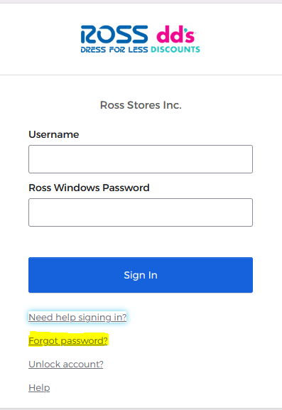
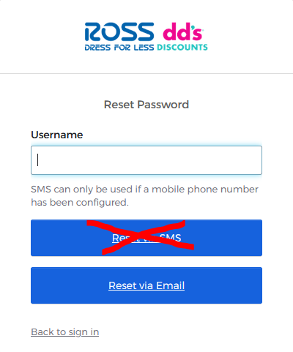
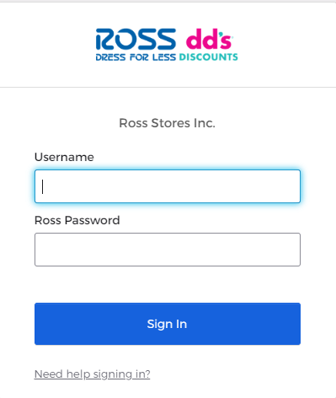
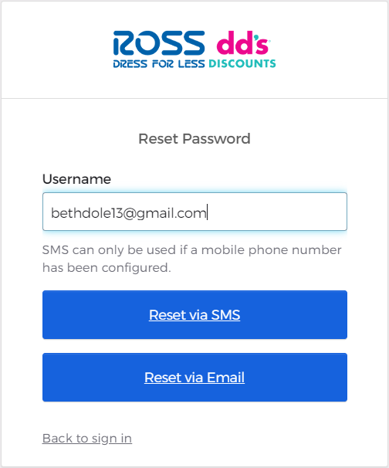
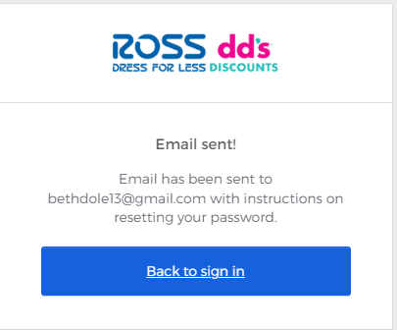
0.3 Supplier Portal –Forgot Password
Log Into Portal, click on Need Help Signing In?
  Click Forgot Password
  Enter your username
  Request via Email (Note: You can’t reset using SMS)
10

Slide 10
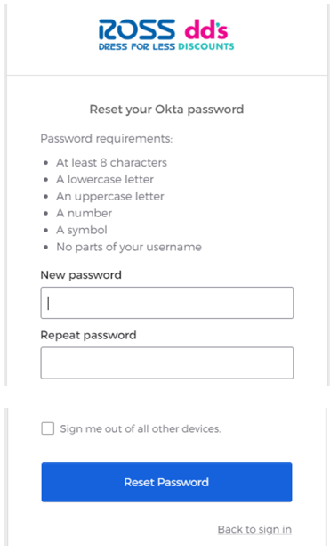
0.3 Supplier Portal –Forgot Password
Check your email and click on the Reset Email link and you will have the option to reset your password
11

Slide 11
Supplier Portal – Single Location
1.3 Supplier Portal – Payments
12

Slide 12

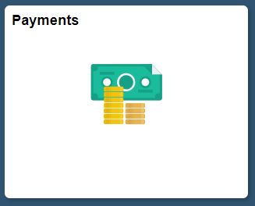
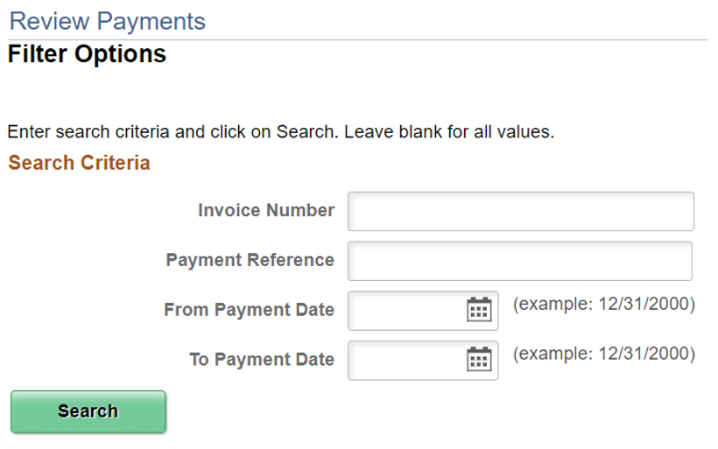
1. Supplier Portal – Payments
To get back to the tile screen press the home button on the top right of the page
Select the Payments Tile
Enter Invoice information then select search
1
2
3
18

Slide 13
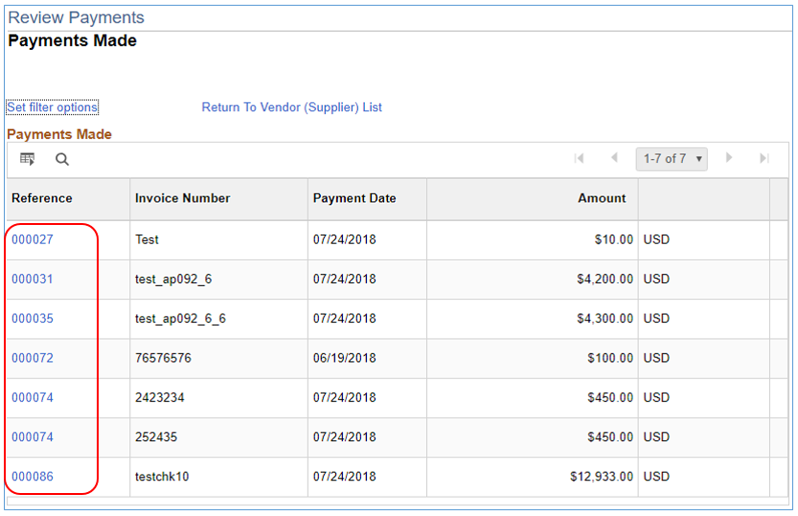

1.3 Supplier Portal – Payments
Payments Made List is displayed based on the search parameters provided.
Click on the Payment Reference ID hyperlink to review details of the payments.
4
19

Slide 14
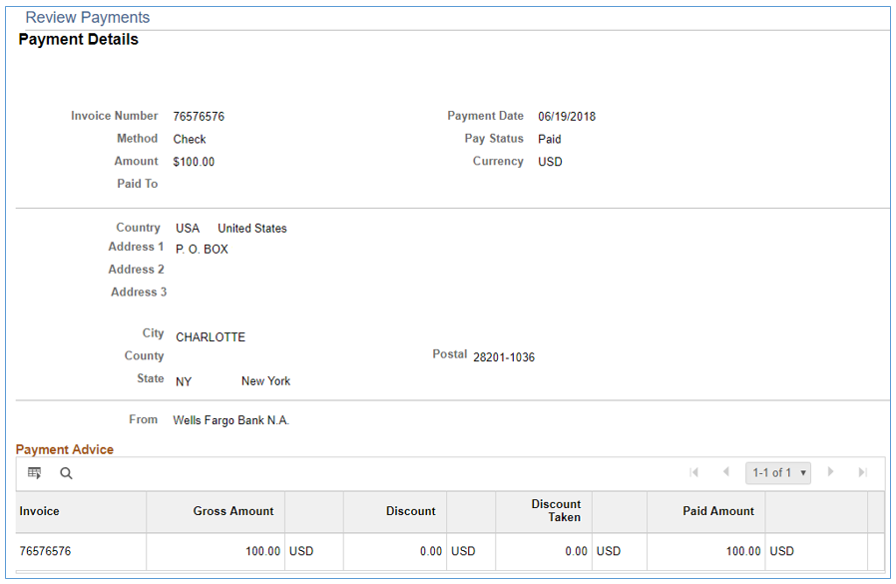

1.3 Supplier Portal – Payments
Payment details are displayed.
20

Slide 15
Supplier Portal – Multiple Vendor IDs
2.2 Supplier Portal – Payments
21

Slide 16
2.2 Supplier Portal – Payments
To get back to the tile screen press the home button on the top right of the page
Select the Payments Tile
Enter Invoice information then select search
1
2
3
29

Slide 17
2.3 Supplier Portal – Payments
Payments Made List is displayed based on the search parameters provided.
Click on the Payment Reference ID hyperlink to review details of the payments.
4
30

Slide 18
2.3 Supplier Portal – Payments
Payment details are displayed.
31

